Slide 1

Day 3: Introduction to Biopython
Mastering Biological Sequence Computing in Python
Modules • Seq Objects • SeqIO • Online Access

Slide 2
Section 1: The Ecosystem
Exploring the core modules and the structural philosophy of Biopython.

Slide 3
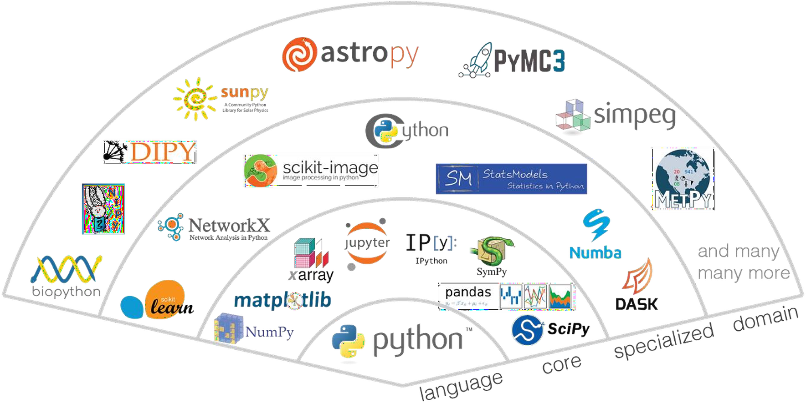

Slide 4

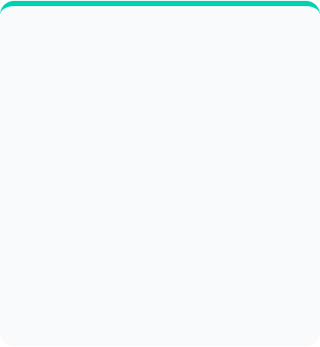
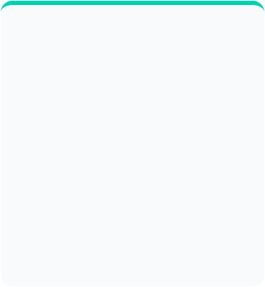
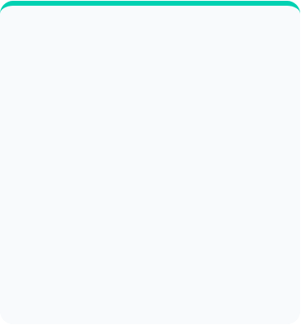



Core Modules Overview
Bio.Seq
Bio.SeqIO
Bio.Entrez
The foundation of biological alphabet management. Handles DNA, RNA, and protein sequences with biological logic.
Universal interface for reading and writing sequence file formats (FASTA, GenBank, FASTQ, etc.).
Programmatic access to NCBI's Entrez databases including PubMed, GenBank, and SNP databases.

Slide 5
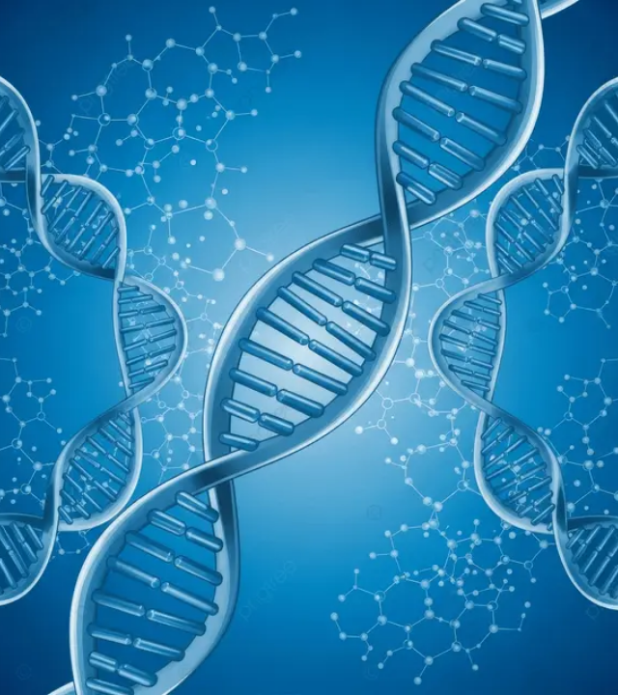
The Seq Object
A sequence object is essentially a string with a biological brain. Unlike standard Python strings, it understands biological transformations.
▪
Immutability: Like strings, Seq objects cannot be edited in-place.
▪
Biological Methods: Transcription, translation, and reverse complementation are built-in.
▪
Alphabet Support: Tracks the biological nature of the sequence.

Slide 6
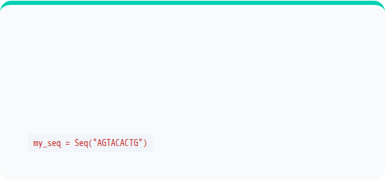
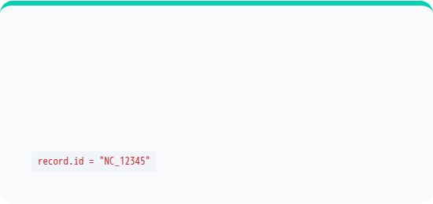
Seq vs. SeqRecord
The Seq Object
The SeqRecord
Represents the raw sequence string. It is the payload.
An "envelope" containing the sequence plus metadata. It is the annotated package.
SeqRecord = Seq + ID + Name + Description + Features

Slide 7
SeqRecord Attributes
Attribute | Type | Description
.seq | Seq Object | The actual DNA/Protein sequence.
.id | String | Primary identifier (e.g., Accession number).
.name | String | A short name for the sequence.
.description | String | A human-readable free-text description.
.features | List | List of SeqFeature objects (genes, exons).

Slide 8
Section 2: Parsing & Databases
Efficiently reading biological data and connecting to online repositories.

Slide 9
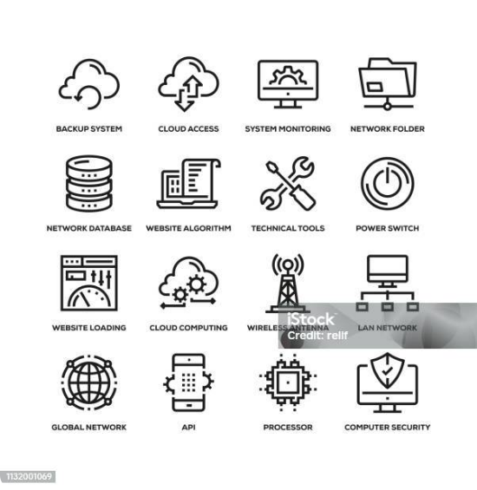
Parsing with SeqIO
Unified Interface
Bio.SeqIO uses a simple syntax regardless of file complexity.
read(): For files with exactly one record.
parse(): For files with multiple records (iterator).
to_dict(): Loads records into a dictionary for random access.

Slide 10
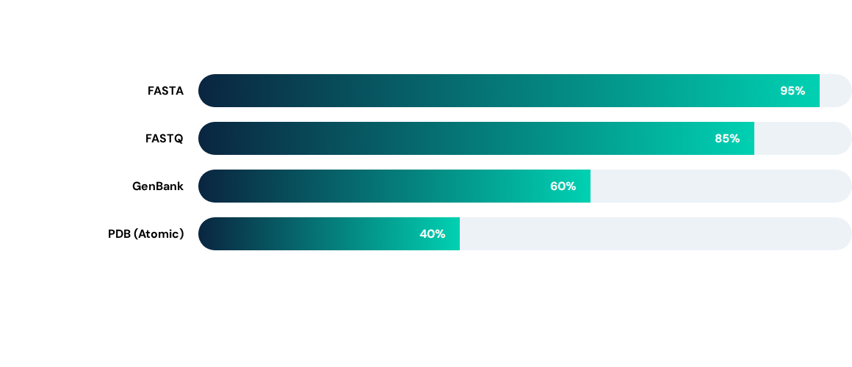
Relative Format Usage
*Estimates based on common bioinformatic pipeline ingestion rates.

Slide 11
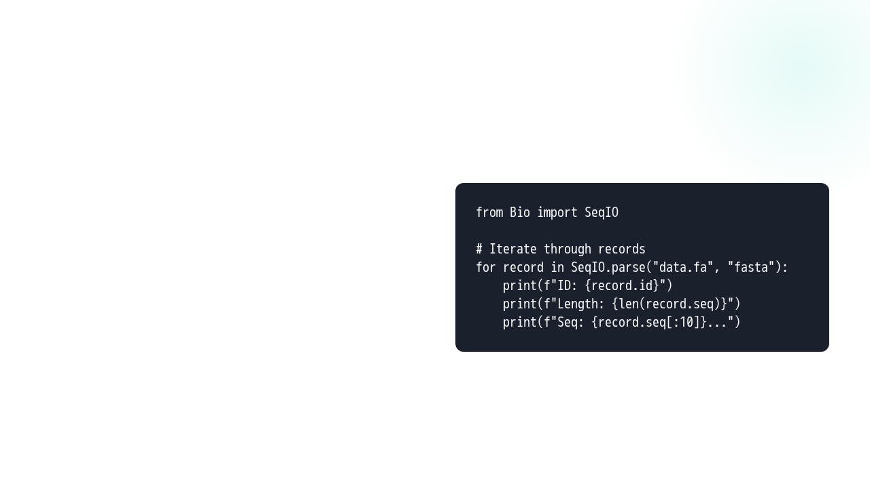


Hands-on: Reading FASTA
Python Implementation
Using an iterator ensures low memory consumption, even for massive sequencing files.

Slide 12

Extracting Sequence Info
Once read, biological properties are just one method away:
GC Content: GC(record.seq) via Bio.SeqUtils
Translation: record.seq.translate()
Reverse Complement: record.seq.reverse_complement()
Slicing: record.seq[0:100] (Biological sub-sequences)

Slide 13
Q&A
Thank you for your attention!
Ready for Day 3 Practical Session?
biopython.org help@bioinformatics.edu

Slide 14




Image Sources
https://png.pngtree.com/thumb_back/fw800/background/20251112/pngtree-abstract-blue-dna-double-helix-structures-with-molecular-background-image_20302800.webp
Source: pngtree.com
https://media.istockphoto.com/id/1132001069/vector/network-technology-line-icon-set.jpg?s=612x612&w=is&k=20&c=2QjcfG4Dqk4hB32aehoBl_vvUrNG7h0IeJZnThLVl4A=
Source: www.istockphoto.com
https://www.earlham.ac.uk/sites/default/files/styles/image_mobile_1x/public/images/articles/Students-need-up-bioinformatics-game-coding-python/Students-bionformatics-game-coding-transferable-skills-770.jpg?itok=PTOPP07y
Source: www.earlham.ac.uk
https://png.pngtree.com/thumb_back/fw800/background/20230624/pngtree-vibrant-dna-helix-or-molecular-structure-rendered-in-3d-image_3671461.jpg
Source: pngtree.com

